Slide 1

Team Name:
Name of College(s)/University(s):
Team Members Details:
Team Member-1
Team Member-2
Team Member-3
Team Member-4

Slide 2

Detailed solution and Approach (250-300 words)
Solution:
Using the OHRC camera, we can obtain video footage from a satellite, allowing us to identify craters and boulders using OpenCV's Video Capture in Python. As the satellite orbits the moon, it detects objects, marking craters in green and boulders in red. Additionally, the system counts the number of craters and boulders, providing their latitude and longitude coordinates.
Approach: 1. TensorFlow
2. Mask RCNN library in python
Open CV library in python
(OR)
Using sample images of craters and boulders, we can identify these features in a specific area. This process includes counting the number of craters and boulders and providing their latitude and longitude coordinates.
Approach: Open CV library in python

Slide 3
Tools and Technology Used (50 words)
Solution 1:
We apply deep learning method for detection and semantic segmentation of craters in an image. Model trained using transfer learning on pretrained MaskRCNN model. Overall project can be divided into four parts as follow:-
Data Preparation
Data Inspection
Training
Testing
Solution 2:
With the sample images of craters & boulders collected, we can train the model using Opencv image capture in Python.

Slide 4
Opportunity should be able to explain the following:
We can identify craters and boulders within a specified distance, providing the number of objects found along with their latitude and longitude coordinates. As the satellite moves around the Moon it identifies the objects found within the area specified.
We can count the number of Craters & boulders found.

Slide 5
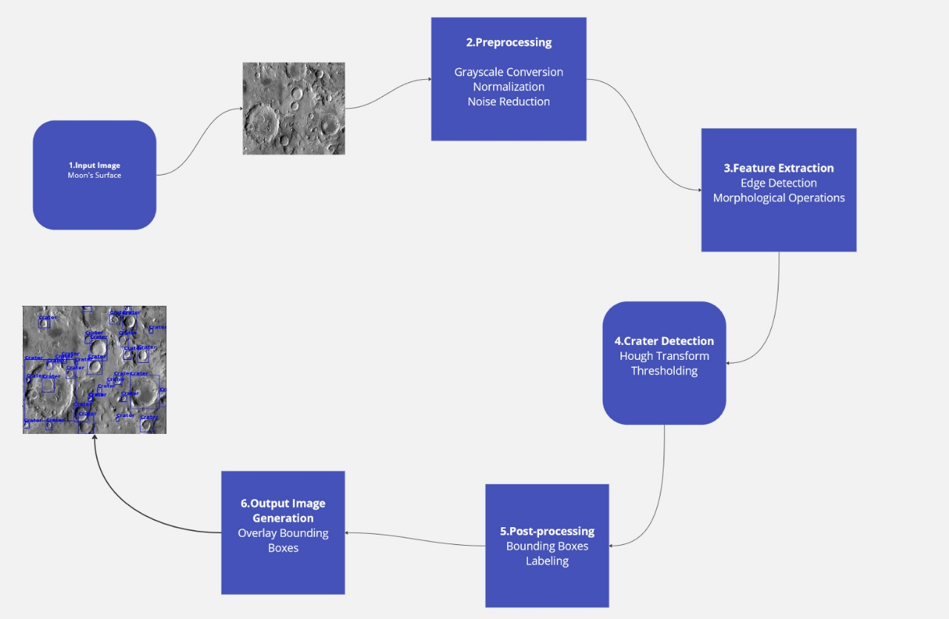
Proposed architecture/user diagram

Slide 6
List of features offered by the solution
It is always better to add a few visual representations (drawings/sketches/illustrations etc.) to your presentation, it adds to the power through which it reaches the audience.

Slide 7
Process flow diagram or Use-case diagram
Add a flow diagram or a use case diagram or an architecture diagram.

Slide 8
Wireframes/Mock diagrams of the proposed solution (optional)

Slide 9
Solution Brief (Overall)

Slide 11


